Slide 1








.
The Australian Imaging Biomarkers and Lifestyle
Flagship Study of Ageing
Commenced 2006
PiB and MRI with follow-up in 288 of the 1100 original participants.
Imaging increased since to 1,515 of 2,135 participants

Slide 2
Progress
Baseline assessment in 2135 subjects with MRI and amyloid PET in 75%.
Added 420 HC from A4 screening.
Added 220 MCI/Mild AD (MMSE >20) from clinical trials screening.
Started 10.5 year review cycle
Amyloid PET and MRI at 0, 18, 38 months then every 3 years
Tau PET – 120 THK5351, 110 AV1451, 20 MK6240 baseline and still evaluating best tracer to use. Only 50 repeat scans (all AV1451).
CSF in 250 subjects but not serial

Slide 3
 | 0m | 18m | 36m | 54m | 72m | 90m | 108m
CN | 1400 | 928 | 766 | 626 | 485 | 419 | 357
MCI | 344 | 166 | 98 | 65 | 48 | 34 | 23
AD | 384 | 275 | 215 | 121 | 60 | 44 | 22
Other | 15 | 5 | 9 | 9 | 7 | 6 | 4
Total | 2143 | 1374 | 1088 | 821 | 600 | 503 | 406
% Follow up | complete | 77.7 | 73.2 | 66.9 | 62.2 | 62.1 | 59.0

Slide 4
Progress
6 year time point scans added to LONI website by end of July. Total baseline scans is 800. Follow-up scans now include with 100 flutemetamol and 105 florbetapir.
Adding amyloid scan classification to AIBL data on GAAIN.
Adding scans and results of florbetaben conversion to centiloid to GAAIN today.

Slide 5
Conversion Equations
Florbetaben CL = 153.4*SUVr_{sm} – 154.9
PiB CL = 93.7*SUVr_{sm} – 94.6
NAV4694 CL = 85.3*SUVr_{sm} – 88
Florbetapir CL = 175.4*SUVr_{sm} – 182.3
Flutemetamol CL = 121.4*SUVr_{sm} – 121.2
Sm = Standard Centiloid Method using SPM8 and ROI from centiloid site on GAAIN

Slide 6
Current Focus
Converting all amyloid results to centiloid units and will revisit previous analyses with larger sample size
Quest for a blood biomarker continues internally and via supply of samples to many academic and commercial groups
Moving to more formal pooling of data with other large cohorts (academic and commercial initiatives)
Supporting clinical drug trials in preclinical and prodromal AD and aiming to move this to a wider national platform
Evaluating tau tracers
Genetic and lifestyle analysis continues
Supporting retinal scans (multispectral; curcumin)

Slide 7
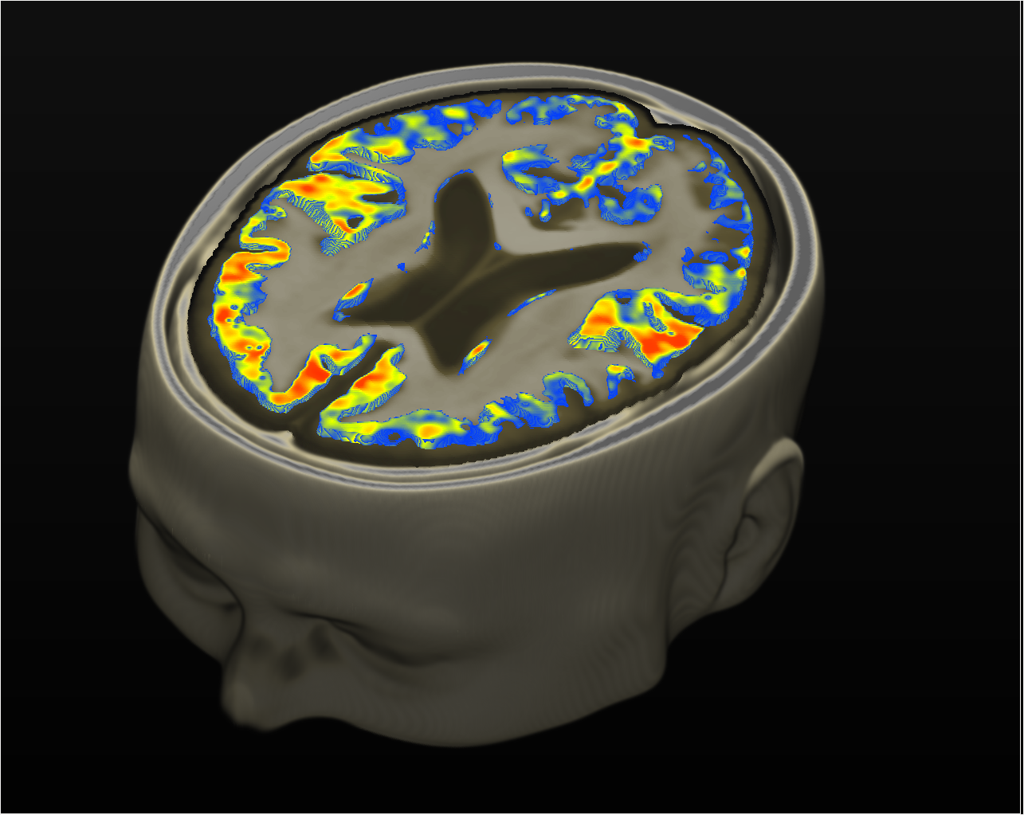
QSM as a measure of brain iron
Heat map presenting the QSM differences between Amyloid positive and negative subjects

Slide 8
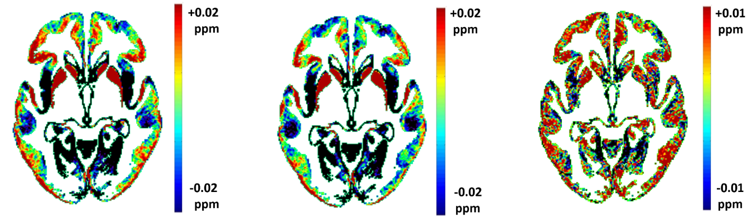

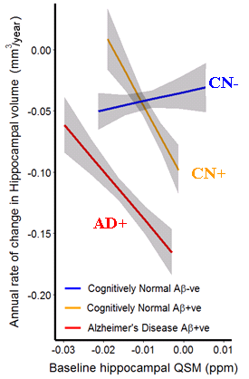
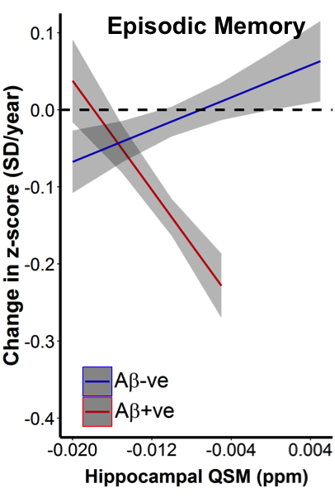
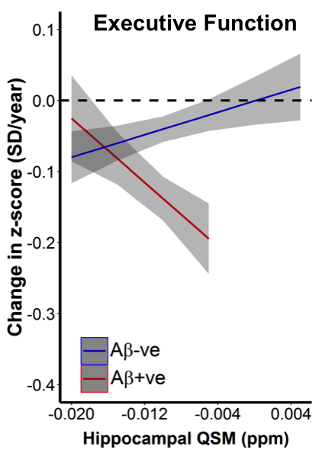
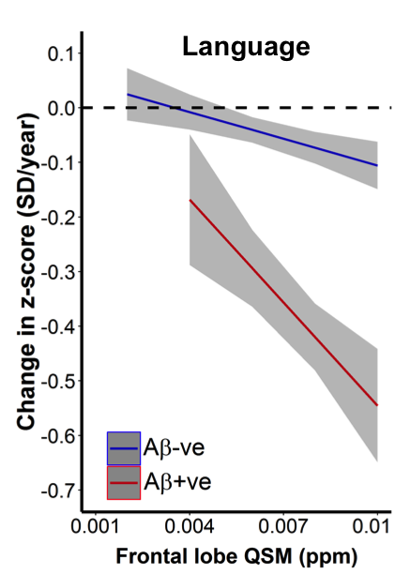
QSM in AIBL
- QSM as a relative measure of iron
Dataset: 117 cross-sectional scans:
53 CN -, 16 CN +, 8 MCI -, 13 MCI +, 27 AD +
Avg. QSM
in Aβ+ve
Avg. QSM
in Aβ-ve
Annual change in Hippo. Volume (mm³/year)
P=0.002
P=0.012
P=0.006
P=9x10⁻⁷
P=0.004
Hippocampal QSM (ppm)
Fazlollahi et. al AAIC 2017
Ayton, Fazlollahi et. al Brain 2017 (accepted)
Notes:
QSM and Atrophy:
analysis was conducted using a mixed effect model to investigate the association of hippocampal volume with baseline QSM-susceptibility, controlling for age, gender, APOE ε4 carrier status and SUVR (continuous variable).
Abeta status was computed using a cut-off of 1.5.
A significant negative association was found between volume and QSM-susceptibility in the hippocampus for Aβ+ CN (β=‒4.22±1.3, p =0.002) and AD (β=‒3.57 ±1.5, p = 0.019), while no significant trend was found for Aβ- CN (figure on the left).
Conclusions:
The results suggest that QSM in combination with Aβ-amyloid PET imaging could be a valuable tool to predict hippocampal atrophy across the AD spectrum.
QSM and cognition:
Different cognitive domains are affected in the presence of both Amyloid and QSM. Therefore cortical iron elevation might combine with Amyloid to accelerate clinical progression in AD.

Slide 9
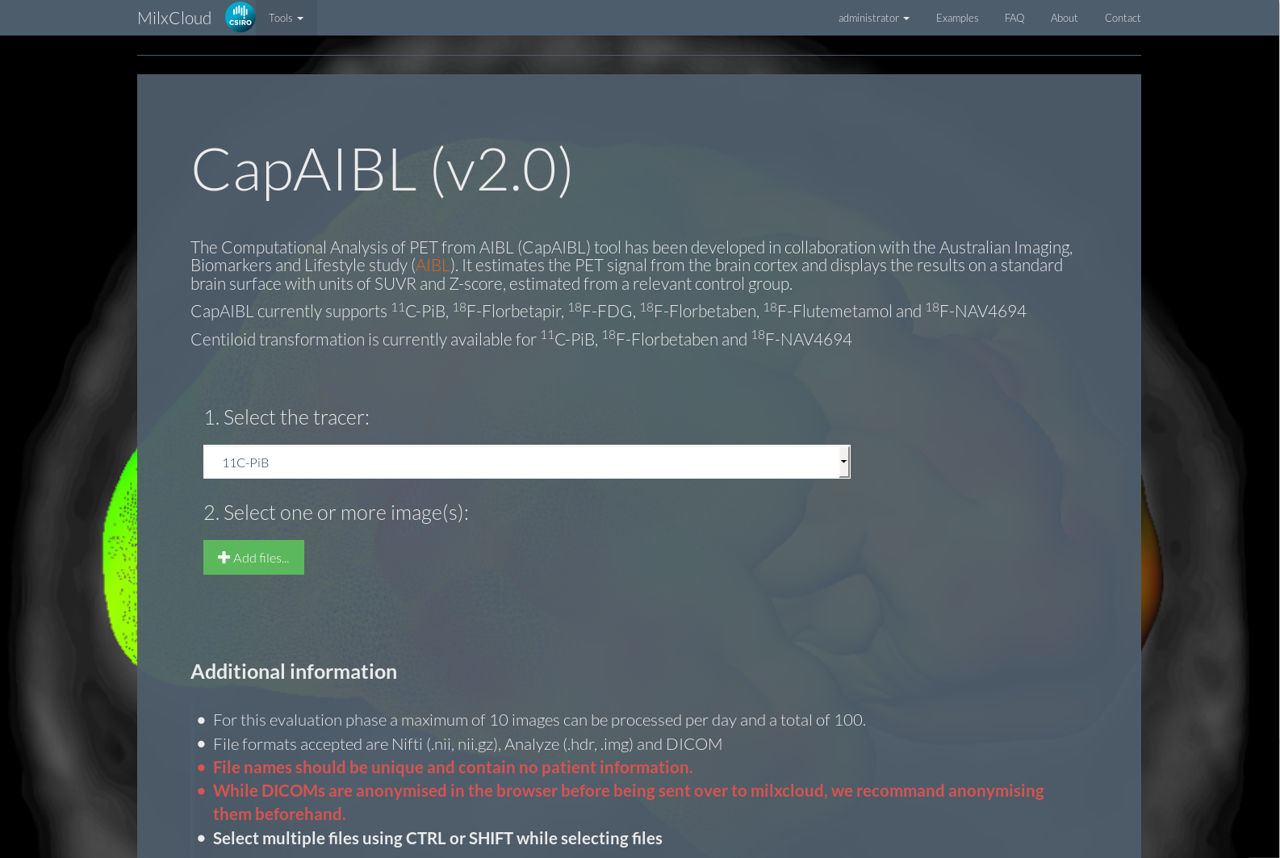
MilxCloud
http://milxcloud.csiro.au

Slide 10
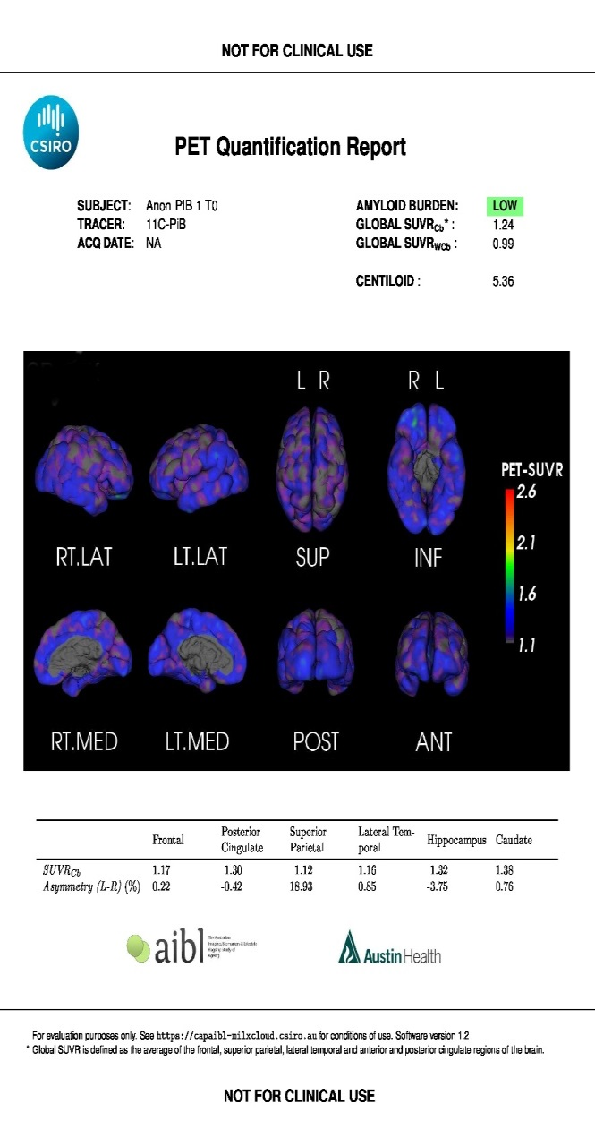
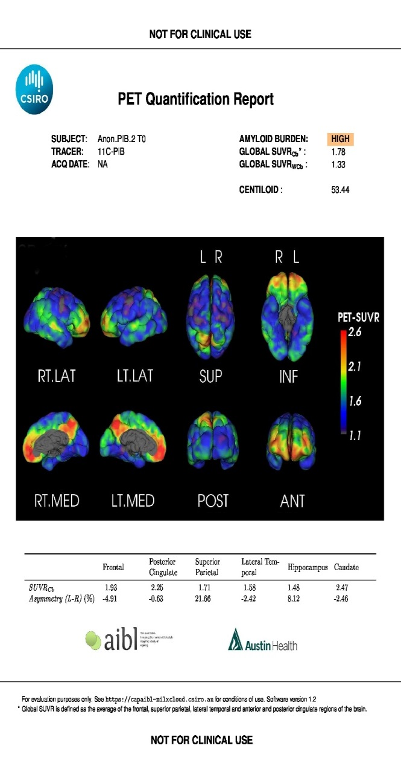
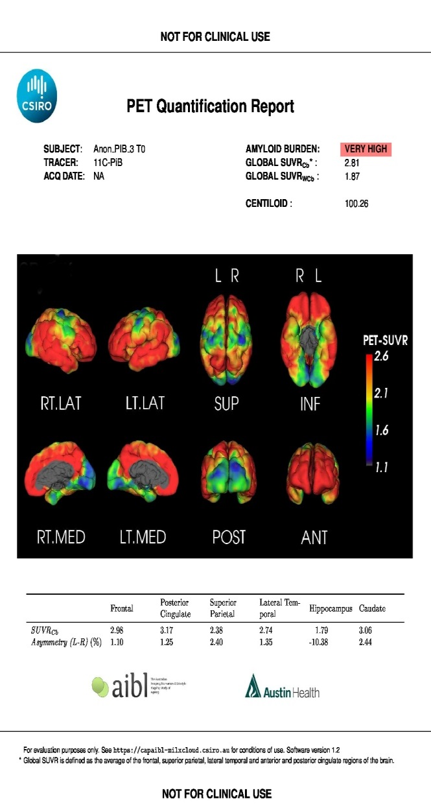
CapAIBL
http://milxcloud.csiro.au

Slide 11
CapAIBL
http://milxcloud.csiro.au
PET only quantification of Amyloid PET images (¹¹C-PiB, ¹⁸F-Florbetapir, ¹⁸F-FDG, ¹⁸F-Florbetaben, ¹⁸F-Flutemetamol and ¹⁸F-NAV4694)
Centiloid quantification for ¹¹C-PiB, ¹⁸F-Florbetaben and ¹⁸F-NAV4694
Pdf reports emailed at the end of processing
20 minutes per scan
Supports Dicom upload

Slide 12
Problems
Retaining amyloid positive participants for longitudinal study – most going into drug trials.
Funding: No direct government support. Reliant on commercial and philanthropic support.

Slide 13
Expression of interest for collaboration or more in-depth data access should go to:
Christopher Fowler - AIBL Co-ordinator
christopher.fowler@florey.edu.au

Slide 14













Acknowledgements
AIBL would like to thank the study participants and their families
AIBL Study team
David Ames
Jenalle Baker
Mary Barnes
Kevin Barnham
Shayne Bellingham
Sabine Bird
Julia Bomke
Pierrick Bourgeat
Sveltana Bozinovski (nee Pejoska)
Belinda Brown
Rachel Buckley
Samantha Burnham
Ashley Bush
Lesley Cheng
Steven Collins
Ian Cooke
Elizabeth Cyarto
David Darby
James Doecke
Vincent Dore
Denise El-Sheikh
Michael Fenech
Shane Fernandez
Binosha Fernando
Christopher Fowler
Maxime Francois
Jurgen Fripp
Shaun Frost
Sam Gardener
Simon Gibson
Veer Gupta
David Hanson
Karra Harrington
Andy Hill
Eugene Hone
Maryam Hor
Gareth Jones
Adrian Kamer
Yogi Kanagasingam
Fiona Lamb
Nicola Lautenschlager
Simon Laws
Wayne Leifert
Hugo Leroux
Qiao-Xin Li
Yen Ying Lim
Florence Lim
Lucy Lim
Linda Lockett
Andrea Louey
Kathy Lucas
Lance Macaulay
Lucy Mackintosh
Ralph Martins
Georgia Martins
Paul Maruff
Colin Masters
Simon McBride
Alissandra Mcilroy
Steve Pedrini
Kayla Perez
Kelly Pertile
Tenielle Porter
Stephanie Rainey-Smith
Carolina Restrepo
Malcolm Riley
Blaine Roberts
Jo Robertson
Mark Rodrigues
Christopher Rowe
Rebecca Rumble
Tim Ryan
Olivier Salvado
Ian Saunders
Greg Savage
KaiKai Shen
Brendan Silbert
Harmid Sohrabi
Kevin Taddei
Tania Taddei
Sherilyn Tan
Christine Thai
Philip Thomas
Brett Trounson
Victor Villemagne
Irene Volitakis
Michael Vovos
Larry Ward
Andrew Watt
Mike Weinborn
Rob Williams
Bill Wilson
Michael Woodward
Paul Yates
Ping Zhang
Collaborators
AIBL is a large collaborative study and a complete list of contributors can be found at www.aibl.csiro.au

